Slide 1

A Framework for Detecting and Explaining Financial Misinformation Using Fine-Tuned BERT Models
A comprehensive framework that leverages fine-tuned BERT models to classify financial claims and provide human-readable explanations for the classifications.

Slide 2
Overview of the Research Paper
Detecting Financial Misinformation
The research paper presents a framework to detect financial misinformation in digital media using fine-tuned BERT models.
Explaining Misinformation
The framework generates human-readable explanations for the misinformation predictions to provide interpretability.
Leveraging FIN-FACT Dataset
The researchers used the specialized FIN-FACT dataset, which contains annotated financial claims to train and evaluate the models.
Fine-Tuned BERT Models
The core of the framework is a fine-tuned BERT model, which is well-suited for the financial domain due to its ability to capture contextual nuances.
Robust Performance
The experimental results showed an Accuracy of 89.2% and a Micro-F1 Score of 87.1%, along with strong explanation quality.

Slide 3
Dataset: FIN-FACT Dataset
Dataset Overview
The FIN-FACT dataset is a specialized dataset for financial misinformation detection, containing a diverse collection of financial claims with four possible labels: True, False, Not Enough Information (NEI), and Neutral.
Claim Annotations
Each claim is annotated with one of the four labels, indicating whether the claim is supported by factual financial data, refuted by verified evidence, lacks sufficient information to verify, or reflects subjective opinions or general statements.
Supporting Evidence
The dataset provides supporting evidence or explanations for each claim, offering additional context to understand the reasoning behind the annotations.
Dataset Preprocessing
The dataset was preprocessed by mapping labels to numerical values, cleaning claims, splitting into training and testing subsets using stratified sampling, and tokenizing claims using BERT's tokenizer.
Challenges
The dataset posed challenges, including an imbalanced label distribution with underrepresented NEI and Neutral labels, and ambiguity in the human-generated explanations.

Slide 4
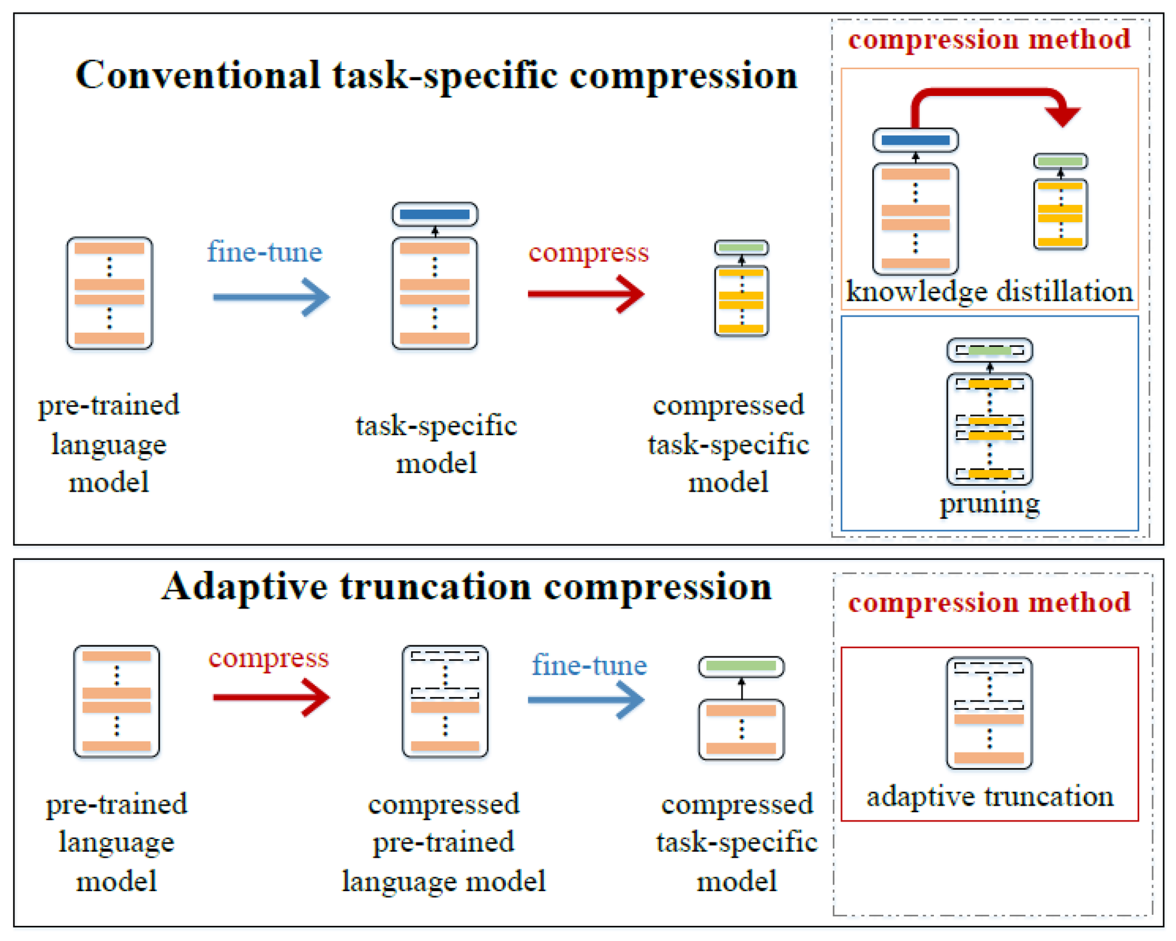
Methodology: Fine-Tuned BERT
The proposed framework leverages the pre-trained BERT model and fine-tunes it on the FIN-FACT dataset to capture contextual nuances in financial claims. This approach allows the model to adapt to the domain-specific characteristics of the dataset, improving its ability to understand and classify financial statements accurately.

Slide 5
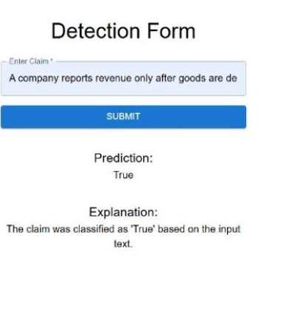
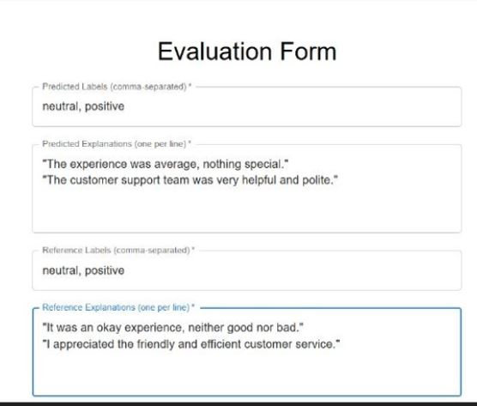
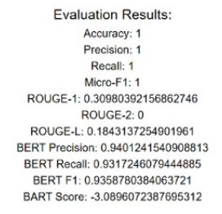
Form Interface

Slide 6


Evaluation Metrics
Metric
Description
Accuracy
Measures the proportion of correctly classified claims.
Precision
Evaluates the model's ability to avoid false positives.
Recall
Assesses the model's ability to identify all relevant claims.
Micro-F1 Score
Combines precision and recall for a holistic performance measure.
ROUGE
Measures lexical overlap between generated explanations and reference explanations. ROUGE-1, ROUGE-2, and ROUGE-L are reported.
BERTScore
Evaluates semantic similarity between generated and reference explanations using BERT embeddings.
BARTScore
Assesses explanation quality using a pre-trained BART model, which considers fluency and informativeness.
*FIN-FACT dataset

Slide 7



Results and Discussions
High Classification Performance
Interpretable Explanations
Challenges with Neutral and NEI Labels
The fine-tuned BERT model achieved an Accuracy of 89.2%, Precision of 87.5%, Recall of 86.8%, and Micro-F1 Score of 87.1% on the FIN-FACT dataset.
The model's generated explanations scored well on ROUGE, BERTScore, and BARTScore metrics, indicating high interpretability.
The model struggled to accurately classify Neutral and Not Enough Information (NEI) labels, suggesting room for improvement in these areas.
The fine-tuned BERT model demonstrated strong performance in financial misinformation detection and generated interpretable explanations, but further work is needed to address the challenges in accurately classifying Neutral and NEI labels.

Slide 8
Conclusion and Future Work
Significant Step Towards Responsible AI in Finance
Explainable and Integrable System
Future Directions: Domain Adaptation
The framework's explainable nature makes it suitable for integration into real-world applications, such as fact-checking tools, media monitoring platforms, and regulatory compliance systems.
The proposed framework represents a significant step towards responsible AI deployment in the financial domain, with the potential to mitigate the spread of misleading claims, enhance regulatory oversight, and improve decision-making for investors, financial institutions, and policymakers.
Extending the framework to handle multilingual financial claims or other domains like healthcare and law, to expand its applicability and impact.
Future Directions: Knowledge Integration
Future Directions: Real-Time Processing
Future Directions: Explainability Improvements
Incorporating external financial knowledge bases or graphs to enhance context understanding and improve predictions for Not Enough Information and Neutral labels.
Optimizing the system for real-time inference to support high-throughput applications and enable timely detection and response to financial misinformation.
Refining the explanation generation module by employing advanced techniques such as SHAP or integrating additional transformer layers fine-tuned for explanation tasks, to further enhance the system's interpretability.

